Slide 1

Mini Project-I (K24MCA18P) Odd Semester Session 2024-25
Blog Maker
Team Leader: Sujal Gupta and University Roll Number: 2426mca189
Member Names: Subhranshu and University Roll Number: 2426mca708
Member Names: Shivam Chaudhary and University Roll Number: 2426mca339
Project Supervisor:
Ms. Divya Singhal
Assistant Professor

Slide 2
Content
Introduction (1 slide)
Literature Review (2 slides)
Objective of the Project (1 slide)
Technology
Hardware Requirements (Development Environment, Server requirement (if required), Client requirement (if required).
Software Requirements (Language and Platforms like Frameworks, VS code, Android Studio and Jupyter notebook etc. )
Modules (2-3 slides)
Workflow (1 slide)
Reports (For Example: Project : Student Monitoring System, so reports like: Student Marks, Subjects, companies visit, and student appears in placement etc.)
References (1 slide)
Notes:
Font Styles: Times New Roman + Font Size: 25

Slide 3
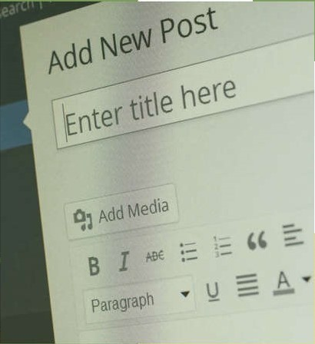
Introduction
Welcome to our presentation on Blog Maker, the ultimate solution for aspiring and seasoned bloggers alike. In an era where content is king, blogging has emerged as a vital tool for personal expression, brand development, and community engagement. Our Blog Maker is designed with a user-centric approach.
With features like customizable templates, an easy-to-use WYSIWYG editor, and built-in SEO tools, we provide everything you need to craft compelling posts that capture attention and drive engagement.
Notes:
Font Styles: Times New Roman + Font Size: 25

Slide 4
Literature Review
Historical Context:
Early research on the impact of blogs on communication and community-building.
Key studies exploring the evolution of blogging platforms (e.g., McGrail, 2010).
Current Trends:
Analysis of user engagement and interaction in modern blogging (e.g., Smith).
The role of SEO and content optimization in driving blog traffic (e.g., Patel, 2021).
Key Themes:
User experience and interface design in blogging tools.
The shift from personal to professional blogging and its implications.
Notes:
Font Styles: Times New Roman + Font Size: 25

Slide 5
Literature Review (Contd.)
Gaps and Future Research Directions
Identified Gaps:
Limited studies on the impact of AI tools on content creation in blogging.
Need for comprehensive analysis of emerging blogging platforms and their features.
Future Research Opportunities:
Investigating user adoption of new technologies in blog creation.
Exploring the effectiveness of different engagement strategies (e.g., multimedia content, interactive features).
Conclusion:
Emphasis on the evolving landscape of blogging and the necessity for ongoing research to understand user needs and technological advancements.
Notes:
Font Styles: Times New Roman + Font Size: 25

Slide 6
Objective of the Project
Primary Objective:
To develop a comprehensive blog-making tool that enhances user experience through intuitive design and advanced features.
Specific Goals:
Security: We prioritize the security of our users and their data. To ensure a safe blogging environment, we will implement the following measures:
Enhance User Engagement: Integrate interactive features like comments, remove and easy update.
Long-Term Vision:
To create a versatile platform that adapts to evolving blogging trends and meets the diverse needs of content creators.
Notes:
Font Styles: Times New Roman + Font Size: 25

Slide 7
Technology (Hardware Requirements)
Hardware Requirements
Processor: A dual-core processor or higher to handle the demands of running the application smoothly.
RAM: At least 4GB of RAM for optimal performance, particularly when generating images or handling multiple notes.
Storage: Sufficient local storage for users to save their notes, images, and application data securely.
Server-Side (if applicable for any backend services):
Processor: Quad-core processor to efficiently handle incoming requests and manage application logic.
RAM: Minimum of 8GB for smooth server operation and to support concurrent users.
Storage: SSD storage for faster data retrieval and application performance.
Client Requirements
To use Our Software, users will need:
A modern web browser (Chrome, Firefox, Safari, or Edge) to access the application.
An internet connection for initial setup and to utilize AI generation features (if applicable).
Compatible operating system: Windows, macOS, or Linux, as the app is designed to be cross-platform
Notes:
Font Styles: Times New Roman + Font Size: 25

Slide 8
Technology (Software Requirements)
Software Requirements
Frontend Technolgies:
HTML: HTML is the standard markup language used to create the structure of web pages.
CSS: CSS is a stylesheet language used to describe the presentation of HTML elements. It controls the layout, colors, fonts, and overall visual aesthetics of web pages
React.js: React.js is a JavaScript library for building user interfaces, particularly single-page applications.
Backend technologies:
Node.js: A JavaScript runtime environment used for server-side development, enabling the creation of a robust backend to support application logic.
Express.js: A web application framework for Node.js, facilitating the development of APIs and server-side logic.
Database:
MongoDB: MongoDB is a NoSQL database that uses a flexible, document-oriented data model, Itis designed for scalability and performance, supporting high availability and large volumes of data, which makes it a popular choice for modern web applications.
Notes:
Font Styles: Times New Roman + Font Size: 25

Slide 9
Modules
Admin Module:
Admins can Sign Up or Sign In to create, update, and remove blogs.
User Module:
Users can Sign Up or Sign In to read or explore blogs by their genre, posted by our admins.
Notes:
Font Styles: Times New Roman + Font Size: 25

Slide 10
Modules (Contd.)
Authentication Module:
This module helps users secure their sensitive data from hackers or any potential data leaks.
It also helps developers identify a particular user to restrict or block them.
Notes:
Font Styles: Times New Roman + Font Size: 25

Slide 11
Workflow/Gantt Chart
Sign Up/Sign In : Both users and admins can sign up or sign in using their credentials.
Admin Dashboard:
Create Blogs: Admins can compose and publish new blog posts.
Update Blogs: Admins can edit existing blogs to correct or add new information.
Delete Blogs: Admins can remove blogs that are no longer relevant.
User Access:
Users can sign in to explore the blog section.
Read Blogs: Users have access to all available blog posts and can read blogs by genre or category.
Blog Management: :
Admins can view and manage all published blogs, with options to update or remove them as needed.
Notes:
Font Styles: Times New Roman + Font Size: 25

Slide 12
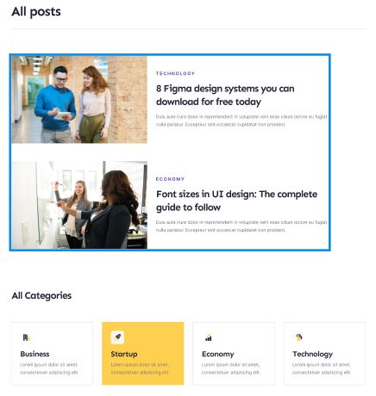
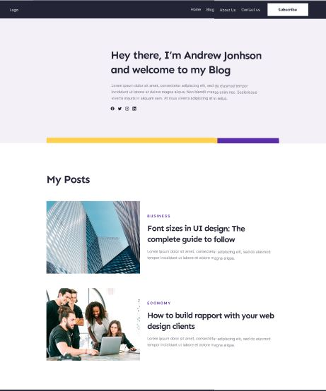
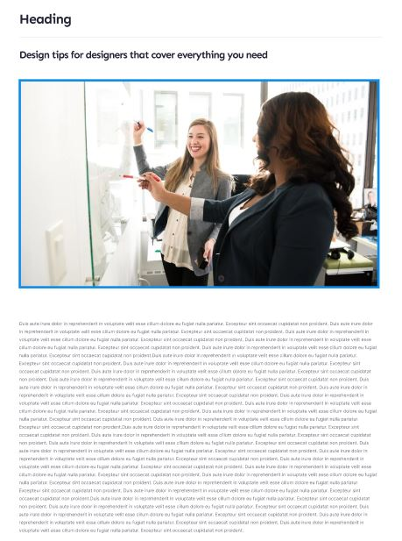
Reports
Notes:
Font Styles: Times New Roman + Font Size: 25

Slide 13
References
Books:
"The Art of Blogging: How to Create a Successful Blog" by Mark L. Young
Websites:
Neil Patel's Blog:
Offers extensive resources on blogging, SEO, and digital marketing strategies.
Moz Blog:
A reputable source for SEO best practices and tips relevant to blogging.
Self-Ideas and Observations
Drawing from personal experiences and user needs to create a more efficient and user-friendly note-taking app.
Observing the limitations of traditional note-taking apps and aiming to solve these real-life problems with innovative features.
Notes:
Font Styles: Times New Roman + Font Size: 25

